Slide 1
analysis of deep learning phenomenons
By Vipasha vaghela

Slide 2
Sgd ( Stochastic gradient descent )
iterative method for optimizing an objective function with suitable smoothness properties (e.g. differentiable or subdifferentiable). It can be regarded as a stochastic approximation of gradient descent optimization, since it replaces the actual gradient (calculated from the entire data set) by an estimate thereof (calculated from a randomly selected subset of the data). Especially in high-dimensional optimization problems this reduces the computational burden, achieving faster iterations in trade for a lower convergence rate.[1]
While the basic idea behind stochastic approximation can be traced back to the Robbins–Monro algorithm of the 1950s, stochastic gradient descent has become an important optimization method in machine learning.

Slide 3
More information
GD is generally noisier than typical Gradient Descent, it usually took a higher number of iterations to reach the minima, because of its randomness in its descent. Even though it requires a higher number of iterations to reach the minima than typical Gradient Descent, it is still computationally much less expensive than typical Gradient Descent. Hence, in most scenarios, SGD is preferred over Batch Gradient Descent for optimizing a learning algorithm.
def SGD(f, theta0, alpha, num_iters):
start_iter = 0
theta = theta0
for iter in xrange(start_iter + 1, num_iters + 1):
_, grad = f(theta)
# there is NO dot product ! return theta
theta = theta - (alpha * grad)

Slide 4
ADAM Optimizer
Adam is an optimization algorithm that can be used instead of the classical stochastic gradient descent procedure to update network weights iterative based in training data.Parameters update are invariant to re-scaling of gradient — It means that if we have some objective function f(x) and we change it to k*f(x) (where k is some constant). There will be no effect on performance. We will come to it later.
The step-size is approximately bounded by the step-size hyper-parameter. (Notice that something is in bold here!).
It doesn’t require stationary objective. That means the f(x) we talked about might change with time and still the algorithm will converge.
Naturally performs step size annealing. Well remember the classical SGD, we used to decrease step size after some epochs, nothing as such is needed here.

Slide 5
Activation functions

Slide 6
Rectified Linear Unit (ReLU)
In a neural network, the activation function is responsible for transforming the summed weighted input from the node into the activation of the node or output for that input.
The rectified linear activation function or ReLU for short is a piecewise linear function that will output the input directly if it is positive, otherwise, it will output zero. It has become the default activation function for many types of neural networks because a model that uses it is easier to train and often achieves better performance.
The sigmoid and hyperbolic tangent activation functions cannot be used in networks with many layers due to the vanishing gradient problem.
The rectified linear activation function overcomes the vanishing gradient problem, allowing models to learn faster and perform better.
The rectified linear activation is the default activation when developing multilayer Perceptron and convolutional neural networks

Slide 7
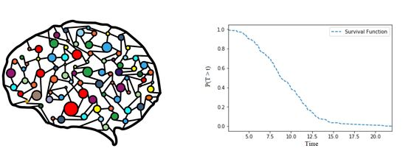
Implementation
import tensorflow as tf
conv_layer = tf.layers.conv2d(
inputs=input_layer,
filters=32,
kernel_size=[5, 5],
padding='same',
activation=tf.nn.relu,
)
import torch
from torch import autograd, nn
relu = nn.ReLU()
var = autograd.Variable(torch.randn(2))
relu(var)

Slide 8
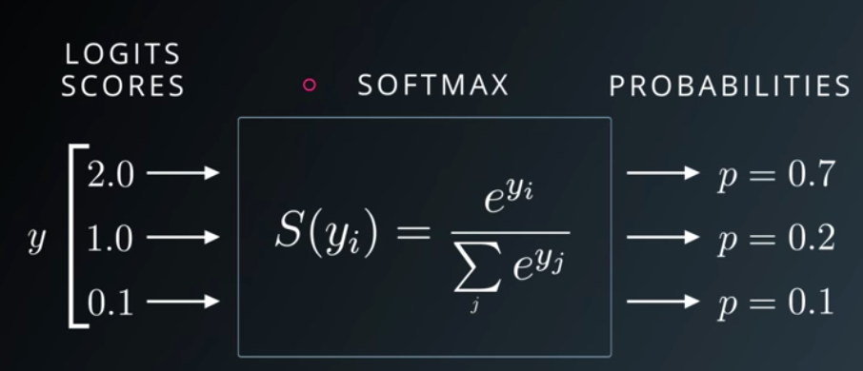
Softmax activation function
wonderful activation function that turns numbers aka logits into probabilities that sum to one. Softmax function outputs a vector that represents the probability distributions of a list of potential outcomes. It’s also a core element used in deep learning classification tasks.

Slide 9
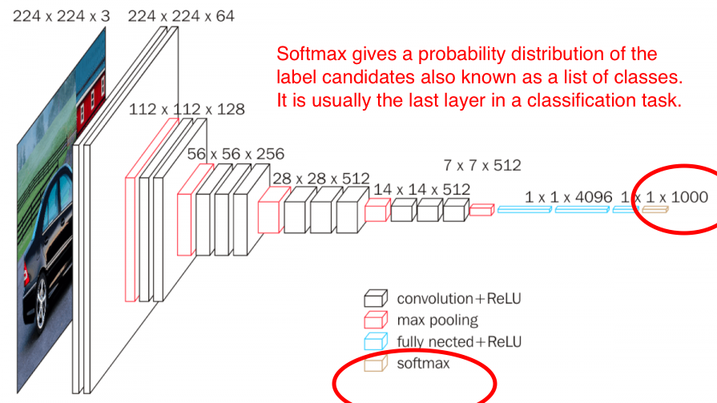
def softmax(x):
return np.exp(x) / np.sum(np.exp(x), axis=0)
Where does the Softmax function fit in a CNN architecture. Image augmented from neurohive cnn. As shown above, Softmax’s input is the output of the fully connected layer immediately preceeding it, and it outputs the final output of the entire neural network. This output is a probability distribution of all the label class candidates

Slide 10
Difference
Cross entropy
Categorical cross entropy
The cross-entropy compares the model's prediction with the label which is the true probability distribution. The cross-entropy goes down as the prediction gets more and more accurate. It becomes zero if the prediction is perfect. As such, the cross-entropy can be a loss function to train a classification model.
Categorical crossentropy is a loss function that is used in multi-class classification tasks. These are tasks where an example can only belong to one out of many possible categories, and the model must decide which one.
Formally, it is designed to quantify the difference between two probability distributions.

Slide 11
